Slide 1
CASE STUDY 2:
PUTTING TWITTER DATA INTO THE CLOUD
Group 9
Abigail Albuquerque, Aria Yan, Isabel Herrero Estrada, Megan Sin, Sandra Phan
Notes:
ABBY - Hello everyone, we are group 9 and this is our case study 2. My name is Abigail. Everyone introduces themselves…

Slide 2

Our
Topic of interest
Notes:
ABBY- So our topic of interest is Formula One racing. Formula 1 is one of the most premier forms of car racing in the world. It has a worldwide viewership of over 430 million in 2020, gathering about a million viewers per race from just the United States alone. The industry is worth over $4 billion dollars. We chose this topic because of its wide reach and audience. What makes F1 unique is its global following. Unlike say the NFL or the NBA in the US, F1 competitions occur globally and are followed by a wide range of people. With high revenue and high viewership, a large media following naturally follows suit. From Netflix shows to household names of world famous drivers such as Hamilton and Schumacher, the media cloud is filled with F1 data that can be easily accessed and analyzed to learn something new. Formula 1 is also a great area to look into as it's fairly narrowed down already. In fact, there are only ten teams competing in these races each season, making it much simpler for us as data scientists to look into. When sports like soccer have thousands of teams and hunderns of famous active players, F1 is able to provide us with an advantageous position. We have therefore decided to look into the Twitter data of Formula 1 and it’s most known race drivers.

Slide 3
KEYWORDS WE SEARCHED FOR
Lance Stroll
Yuki Tsunoda
George Russell
Kimi Raikkonen
Nicholas Latifi
Antonio Giovinazzi
Fernando Alonso
Esteban Ocon
formula 1
formula one
F1
Max Verstappen
Lewis Hamilton
Valterri Bottas
Sergio Perez
Carlos Sainz
Charles Leclerc
Mick Schumacher
Nikita Mazepin
Alex Albon
Guanyu Zhou
fia
Daniel Ricciardo
Pierre Gasly
Sebastian Vettel
Notes:
Megan - Here are the keywords we searched for, most of the keywords are drivers from the upcoming races and drivers from the past year’s races.
Why not only last names → mix ups
No team names → cluttered with tweets about other stuff like their vehicles as they are also a car manufacturer not related to f1

Slide 4
Sampling
Data
Tweets collected in total
~3400
Notes:
Megan - process+MongoDB 3 doesn’t allow removing duplication, so this is an overestimate of the true sample data.

Slide 5
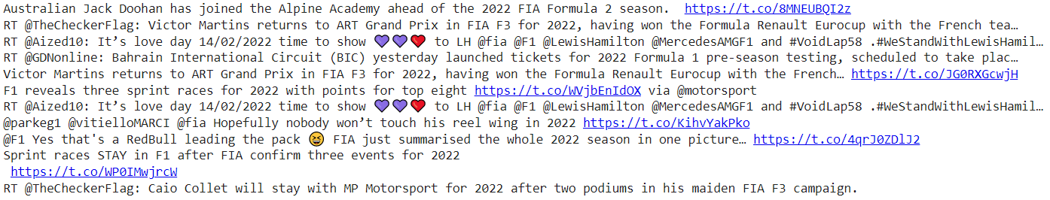
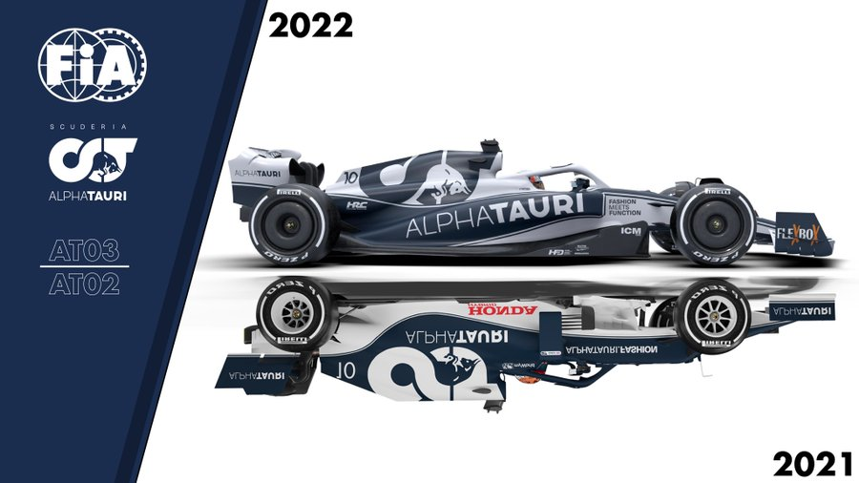
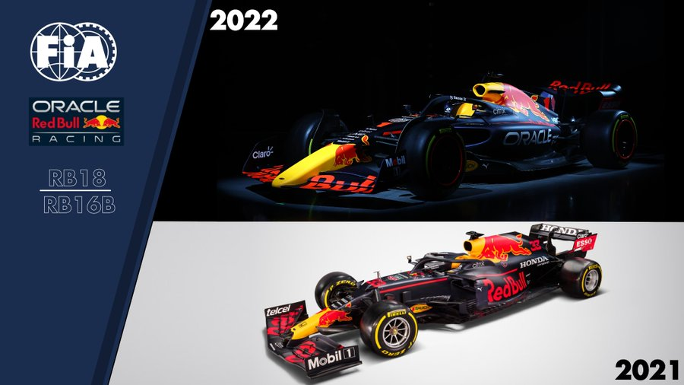
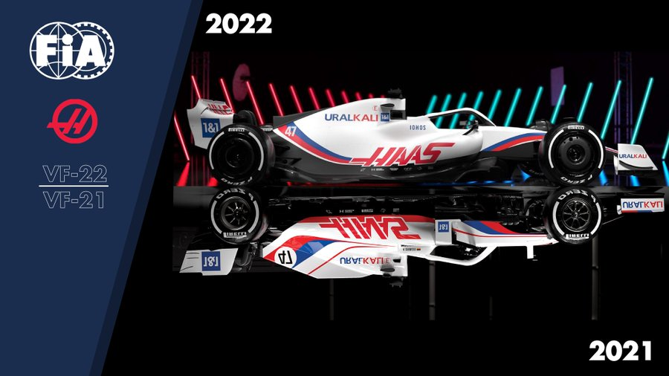
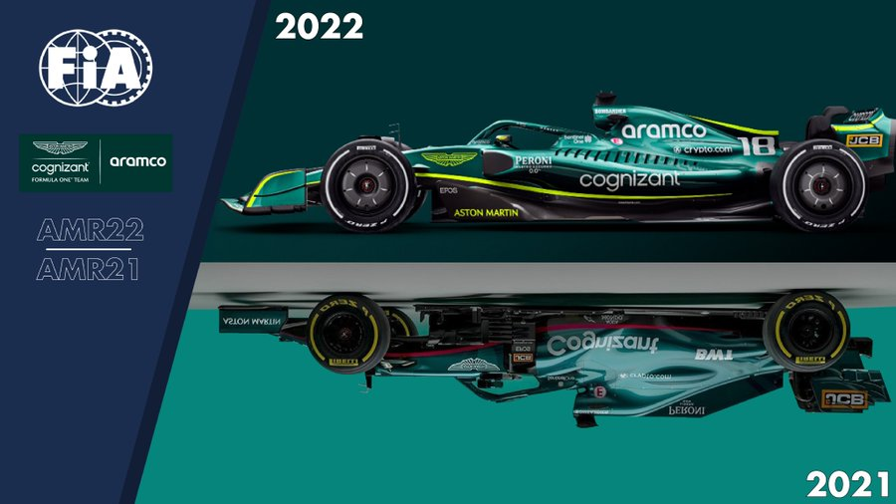
SEARCHING MongoDB
We chose to search and extract tweets that had been retweeted with keyword ‘2022’.
Notes:
Aria - Four of the top 5 retweeted tweets revealing the new car designs based on the new regulations

Slide 6
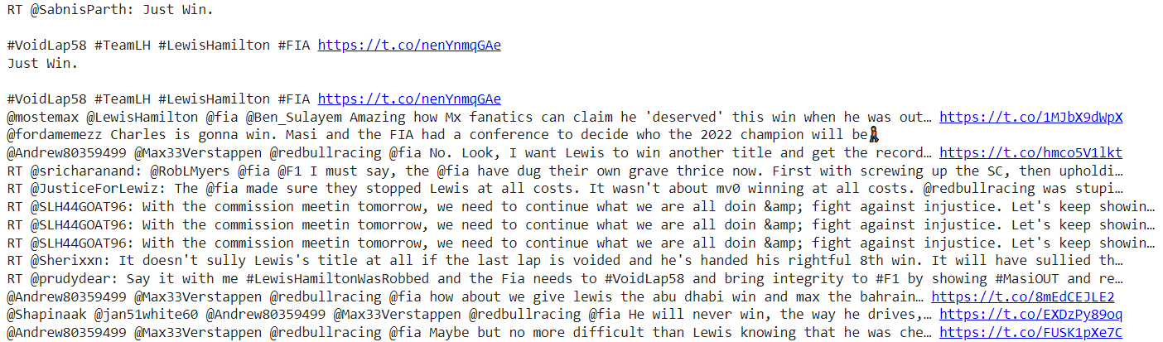
SEARCHING MongoDB
We chose to search and extract tweets that had been retweeted with keyword ‘win’.
Notes:
Aria - We searched for and extracted a subset of tweets that had been retweeted.

Slide 7
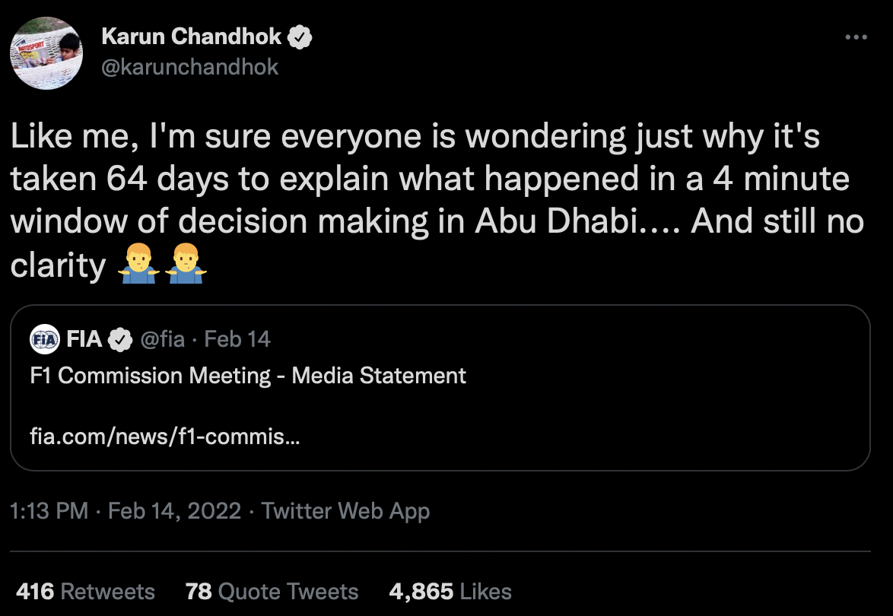
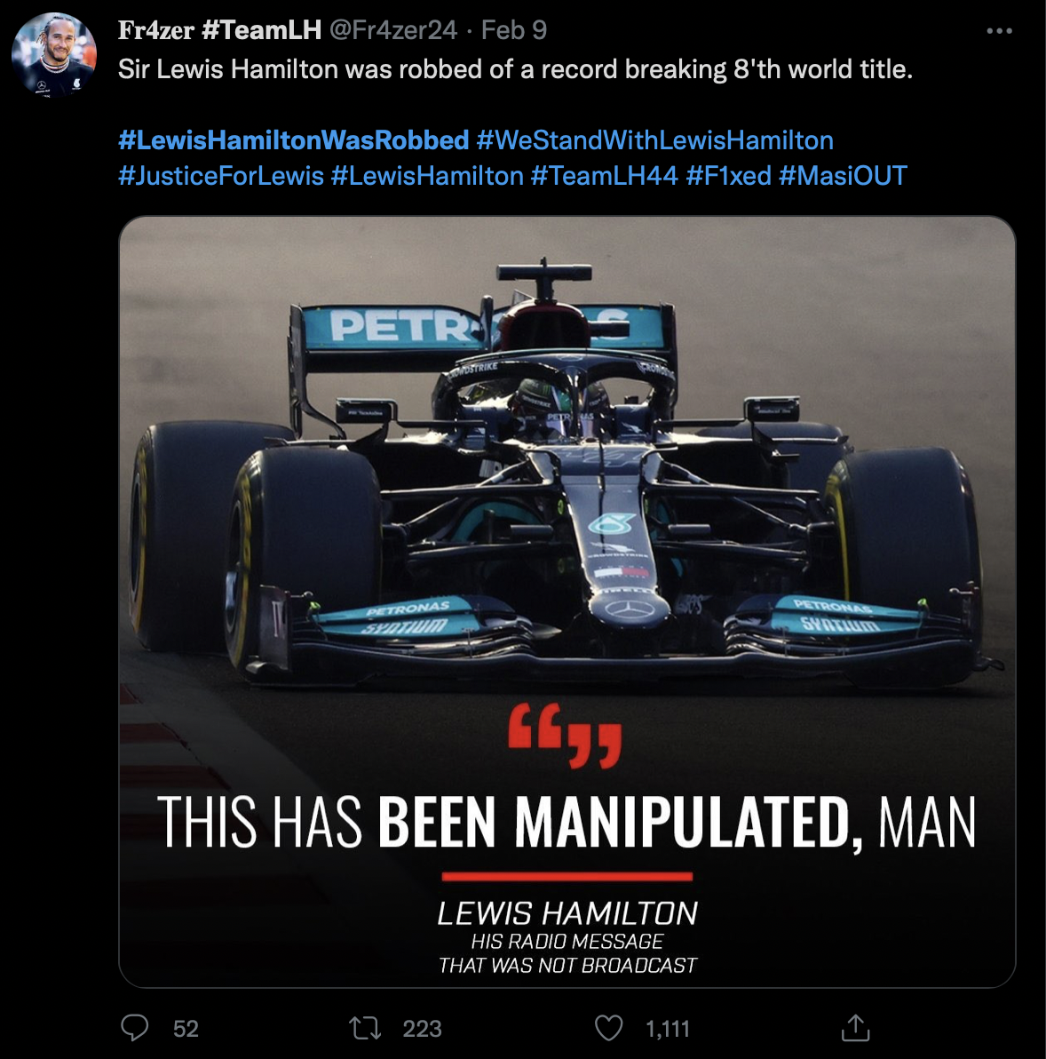
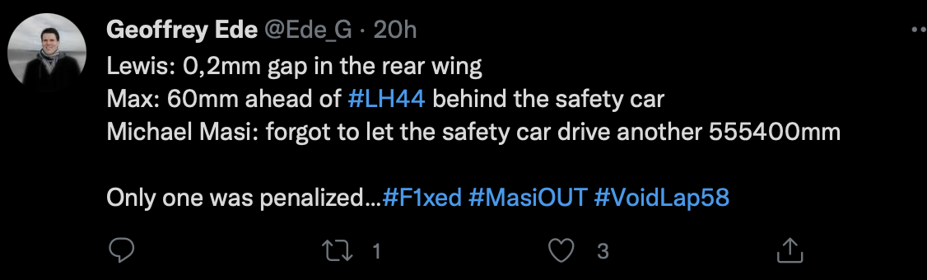
Notes:
Aria - Few tweets we chose from the search results. Mystery tool that will help us in our analysis later.

Slide 8
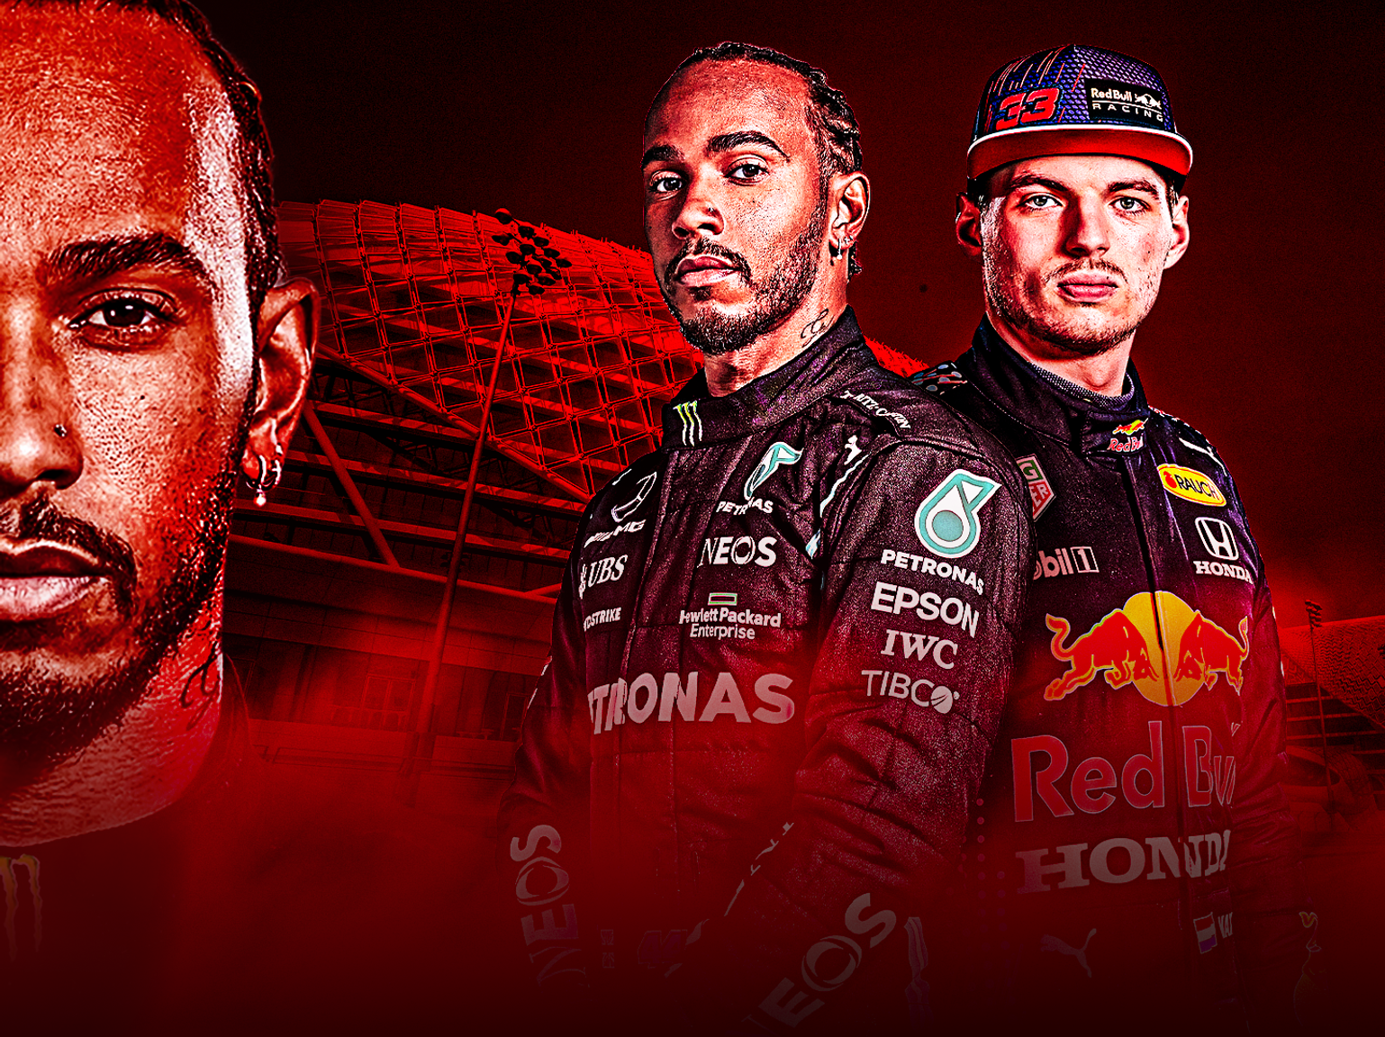
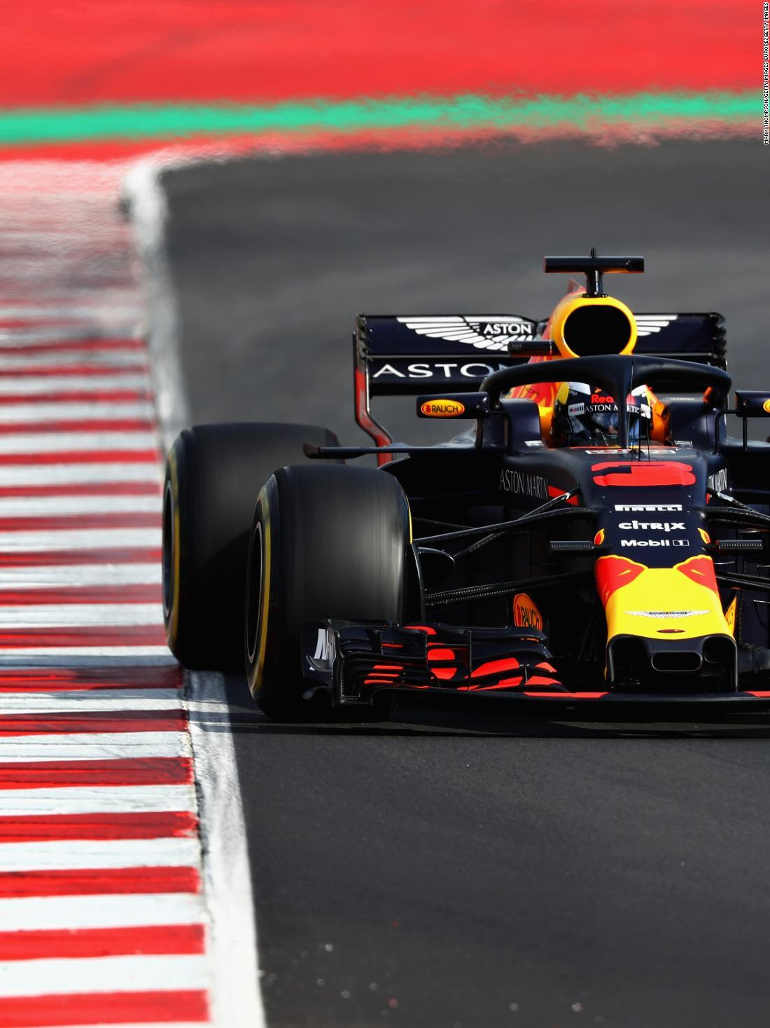
Our business question
How the frequency of keywords (ex: driver’s names) can be used to develop a product or solution that can be sold to companies.
Notes:
isabel

Slide 9
Our business case
Our target customer - media outlets.
Use our product to see who is being talked about most/ figure out who is the most popular to decide who the media outlets should highlight more to get more clicks or sell more.
Notes:
isabel

Slide 10
Some experiments with our data
Notes:
sandra

Slide 11
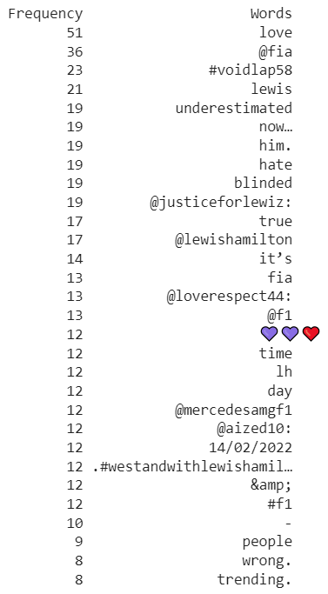
FREQUENCY aNALYSIS
Notes:
sandra

Slide 12
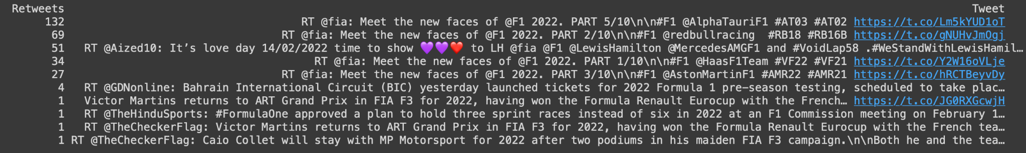
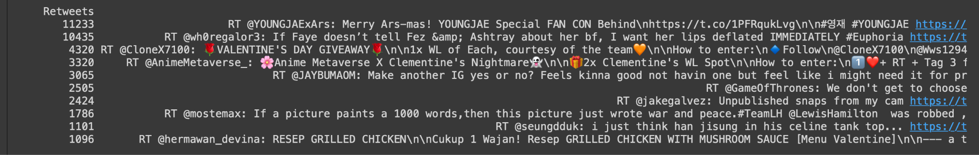
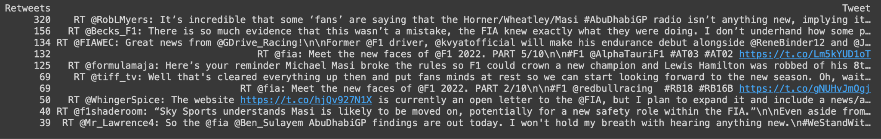
Data exploration using Frequency analysis of retweets
Notes:
sandra

Slide 13
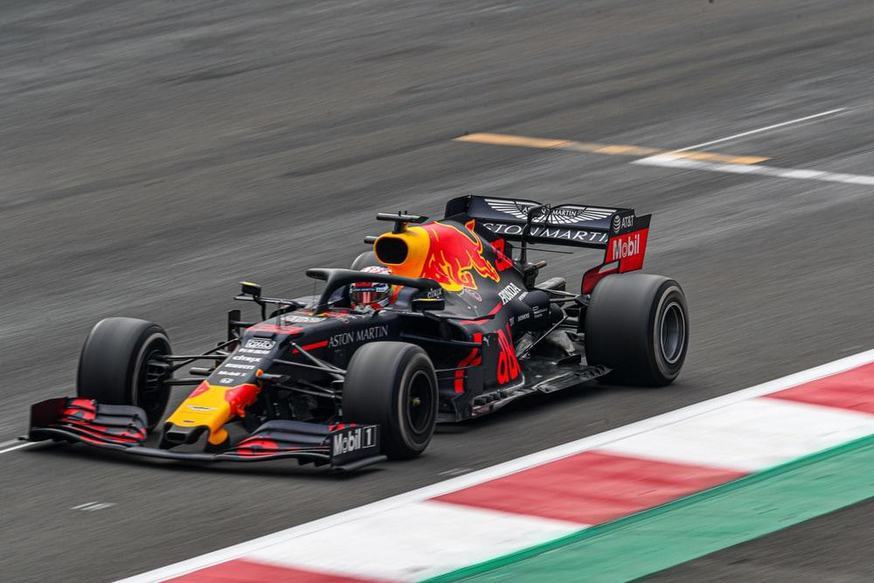
eventually…
Learn public perception/ public feelings about issues. In our case public perception about other drivers /teams through sentiment analysis.
Notes:
Sandra

Slide 14
Thanks for listening!
Do you have any questions?
Notes:
sandra

